Slide 1
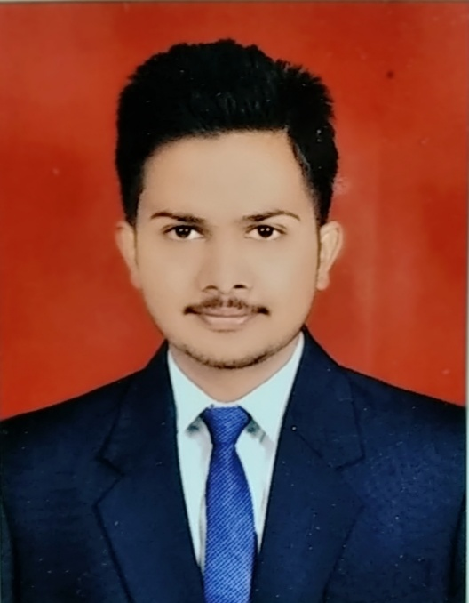
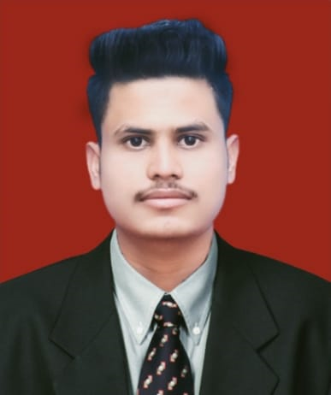
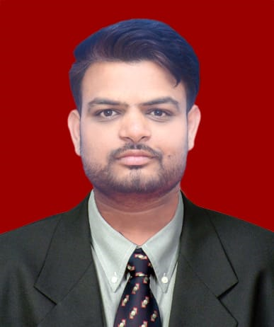
PLACEMENT 2022-23
Sr. No | Name of Student | Name of Company/Industry | Students Mob.No | Email | Photo | Package LPA
1 | Mr.Ajay Bhagwat Dhage | GEO SPATIAL | 8805421294 | ajaydhage.nbnsscoe.civil@gmail.com |  | 2.16
2 | Mr.Abhijeet Balasaheb Salunke | GEO SPATIAL | 7756951146 | abhijeetsalunke51@gmail.com |  | 2.16
3 | Mr.Suraj Rajendra Chouhan | GEO SPATIAL | 9518323203 | surajchouhan.nbnscoe.civil@gmail.com |  | 2.16
4 | MrAmar Shivaji Koli | GEO SPATIAL | 8485820586 | amarkoli0596@gmail.com |  | 2.16

